Slide 1

UltraSE: Single-Channel Speech Enhancement Using Ultrasound
Ke Sun and Xinyu Zhang
University of California, San Diego
MobiCom’21, Mar 30th, 2022
Notes:
Hi everyone. Thank you for attending my presentation. I am Ke, a 3rd year Ph.D. student from UCSD advised by Prof. Xinyu Zhang. Today, I will present our work ``UltraSE: Single-Channel Speech Enhancement Using Ultrasound’’.

Slide 2
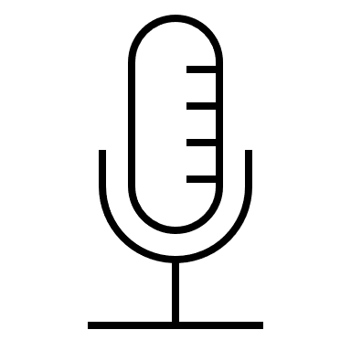
Motivation
Human-to-human
Human-to-computer interaction
Microphone
Speech Signals
Targeted user
Notes:
Speech communication is known as one of the most common communication methods for both human-human and human-computer interaction.
Typically, for mobile devices, the speech signals are recorded by the microphone, and used by the user interface.

Slide 3
Motivation
Clean Speech
Of Targeted User
Targeted user
Speech Separation
& Enhancement
Microphone
Noise sources
Speech Separation & Enhancement: the holy grail of speech processing
Notes:
However, when there exist noisy sound sources in the environment, the recorded sound will contain both noise and target speech. Speech separation and enhancement algorithms are used to extract the target user's speech in such scenarios. This kind of task is considered as the holy grail of speech processing because of its wide usage.

Slide 4
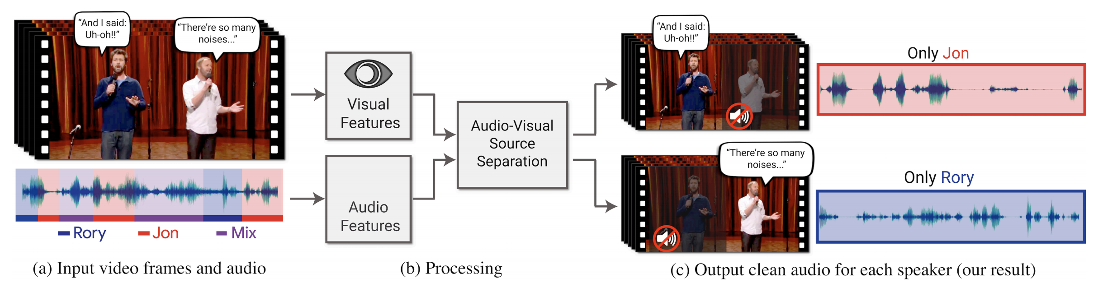
Motivation
Challenging scenario: > 1 speakers mixed with background noise.
Audio-only methods are hard to resolve such scenarios.
Speech Separation
& Enhancement
Targeted
User
Noisy
User
Microphone
Noisy Speech
Label permutation problem: Which one is from the targeted user?
Noise sources
Notes:
The more challenging scenario is that a single microphone is used to record more than one speaker speech along with background noise. Audio-only methods are hard to resolve such scenarios. Although advanced deep learning methods show the potential to separate the multiple speakers’ speech, they still face a fundamental challenge called the label permutation problem. As you can see in this Figure, even the speech separation and enhancement method can separate two speech voices, the audio-only method has no idea which one is from the targeted user.

Slide 5
Limitations of prior works
Audio-visual Limitations:
Additional Camera
Angle of view, Lighting conditions, Energy consumption
Looking to Listen at the Cocktail Party: A Speaker-Independent Audio-Visual Model for Speech Separation (SIGGRAPH 2018)
Notes:
Existing work proposes to use the audio-visual-based method to solve this problem. The basic idea is to correlate the speech signals with the mouth movement in the video to realize robust speech separation and enhancement. However, the video-based methods still have fundamental limitations. They may need an additional camera for speech recording, which has a limited angle of view, and can not work well in bad lighting conditions.

Slide 6
Can we use audio-only methods to separate the desired speaker voice from other speakers and noises?
Utilize ultrasound sensing to capture the desired speaker articulatory gestures
Notes:
Our work UltraSE proposes to use the audio-only methods to separate the desired speaker voice from other speakers and noises.
Inspired by the audio-visual method, our basic idea is to use ultrasonic sensing as a complementary modality to capture the desired speaker articulatory gesture and extract the correlated speech signals from the noisy recording signals.

Slide 7
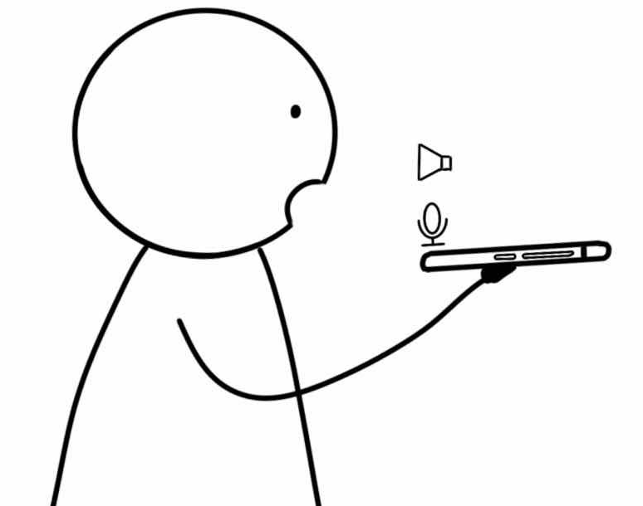
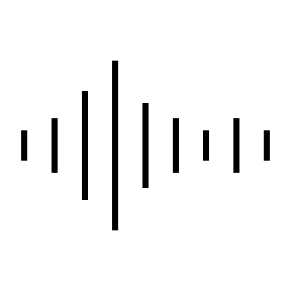
Our solutions
UltraSE:
Loudspeaker transmits 18~22kHz ultrasound.
Microphone receives both speech and ultrasound modulated by lip motion
Advantages
Audio-only
Single-pair mic and loudspeaker
Traditional
Audio Recording
UltraSE
Audio Recording
Notes:
Compared to traditional audio recording, UltraSE transmit ultrasound continuously through loudspeaker. When user is speaking, it will be modulated by the speaker’s articulatory gestures close to the smartphone.
Thus, the microphone captures both the audible sound and reflected inaudible sound.
The key advantage of UltraSE is that this is an audio-only method without any hardware modifications.
It is general to any mobile devices with a single pair of microphone and loudspeaker, like smartphone, smartwatch, etc.

Slide 8
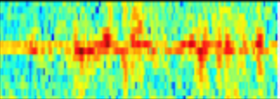
Our solutions
Notes:
After receiving these two modalities, UltraSE employs a novel DNN framework to capture such correlation and denoise the audible sounds. It can be considered as a separated block in traditional speech processing pipeline.

Slide 9
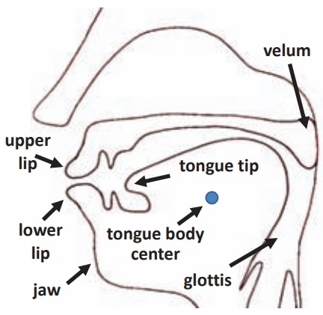
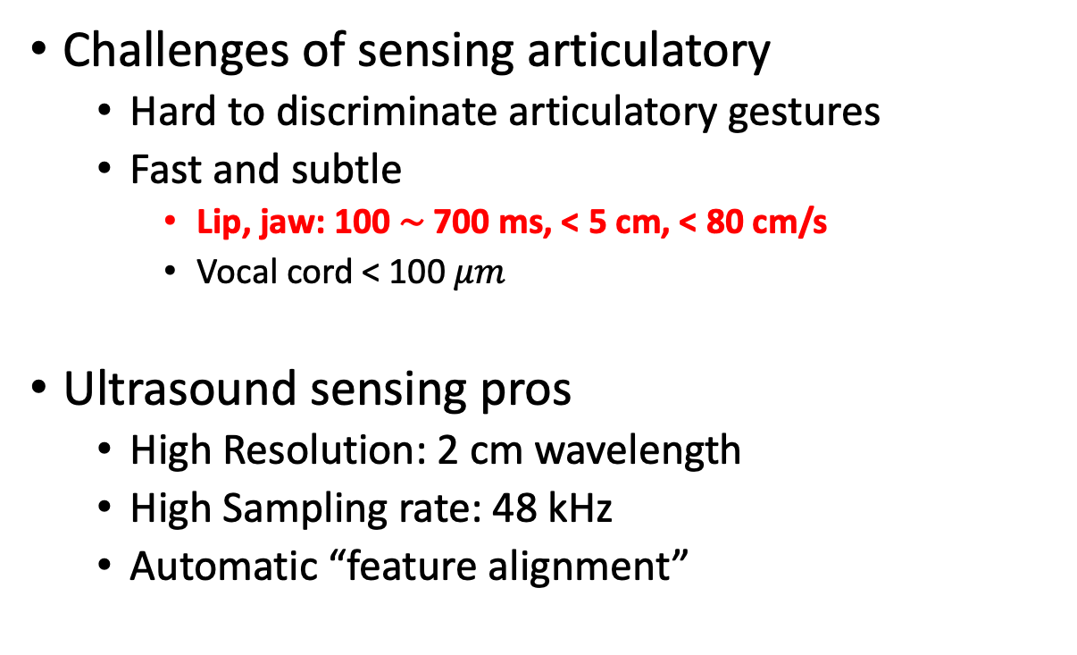
Sensing articulatory gestures
Challenges of sensing articulatory
Hard to discriminate articulatory gestures
Fast and subtle
Lip, jaw: 100 ∼ 700 ms, < 5 cm, < 80 cm/s
Vocal cord < 100 $μm$
Ultrasound sensing pros
High Resolution: 2 cm wavelength
High Sampling rate: 48 kHz
Automatic “feature alignment”
Hearing Your Voice is Not Enough: An Articulatory Gesture Based Liveness Detection for Voice Authentication, CCS 2017
Notes:
Next, I will present how we sense the speaker’s articulatory gestures. It is hard to use ultrasound to discriminate different articulatory gestures, including lip tongue, jaw movement and vocal cord vibration because they are too complex. Meanwhile, the articulatory gestures are also fast and subtle. Ultrasound sensing mainly captures the articulatory gestures with the largest motion from the lip and jaw which is typically less than 5 cm moving distance and less than 80 cm/s speed. In comparison, our ultrasound sensing is not able to capture the vocal cord motion, which involves only less than 100 macro meter vibration.
The advantage of ultrasound sensing here is that it has relative high resolution. The wavelength of 20 kHz ultrasonic signals is less than 2 cm which is sufficient for lip and jaw movement capture. The sampling rate of the signals is 48 kHz which is extremely higher than camera-based methods. And also, since the audible sound and inaudible sound are captured by the same microphone, they have a natural feature alignment while the audio-visual methods typically have hundreds of milliseconds synchronization error.

Slide 10
Sensing articulatory gestures
Transmitted Signals
Multi-tone CW based modulation: Doppler shift
Pro: High T-F Resolution
Con: No distance information
FMCW/ OFDM based modulation: Impulse Response or Range Doppler
Pro: Distance Information
Con: Low T-F Resolution
Notes:
We select the multi-tone continuous wave as our transmitted signals and use doppler shift as the feature in our work because we want to achieve high time-frequency resolution for articulatory gesture sensing.
In contrast, although FMCW or OFDM modulated transmitted signals can capture the channel impulse response or range doppler to characterize the mouth absolute distance information, they can not clearly capture the detailed articulatory gestures Doppler shift because of their low sampling rate. Besides, the distance information is not that important because we mainly consider the handhold scenario where the distance between the smartphone and microphone is relatively stable.

Slide 11
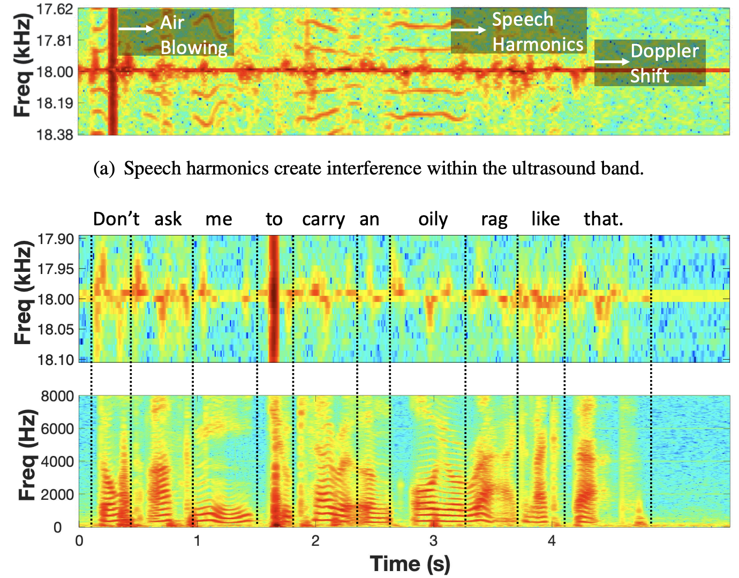
Preprocessing and Interference Mitigation
Feature Extraction
Speech: T-F Spectrogram
Ultrasound: Doppler Shift
Interference
Speech harmonics
Air blowing
Clean Ultrasound Doppler Shift
Audio T-F Spectrogram
Noisy Ultrasound Doppler Shift
Notes:
After receiving the sound signals, we extract the time-frequency domain speech spectrogram for audible sound and time-frequency domain ultrasound Doppler spectrogram for inaudible sound separately.
Although these two modalities have different frequency band, we also find two mutual interference exists between speech and ultrasound which causes ambiguity of Doppler features. First, as you can see, the speech harmonics may interfere the Doppler features due to non-linearity of microphone hardware. Fortunately, we mitigate the harmonics by directly reducing the volume since the second-order term, say the harmonics’ amplitude decreases faster than the first-order term, say the doppler amplitude. Second, some phonemes may blow air flow into the microphone which generates high-volume noise, which corrupts the ultrasound Doppler spectrogram. We harness them as part of our features to characterize the period of specific phonemes.

Slide 12
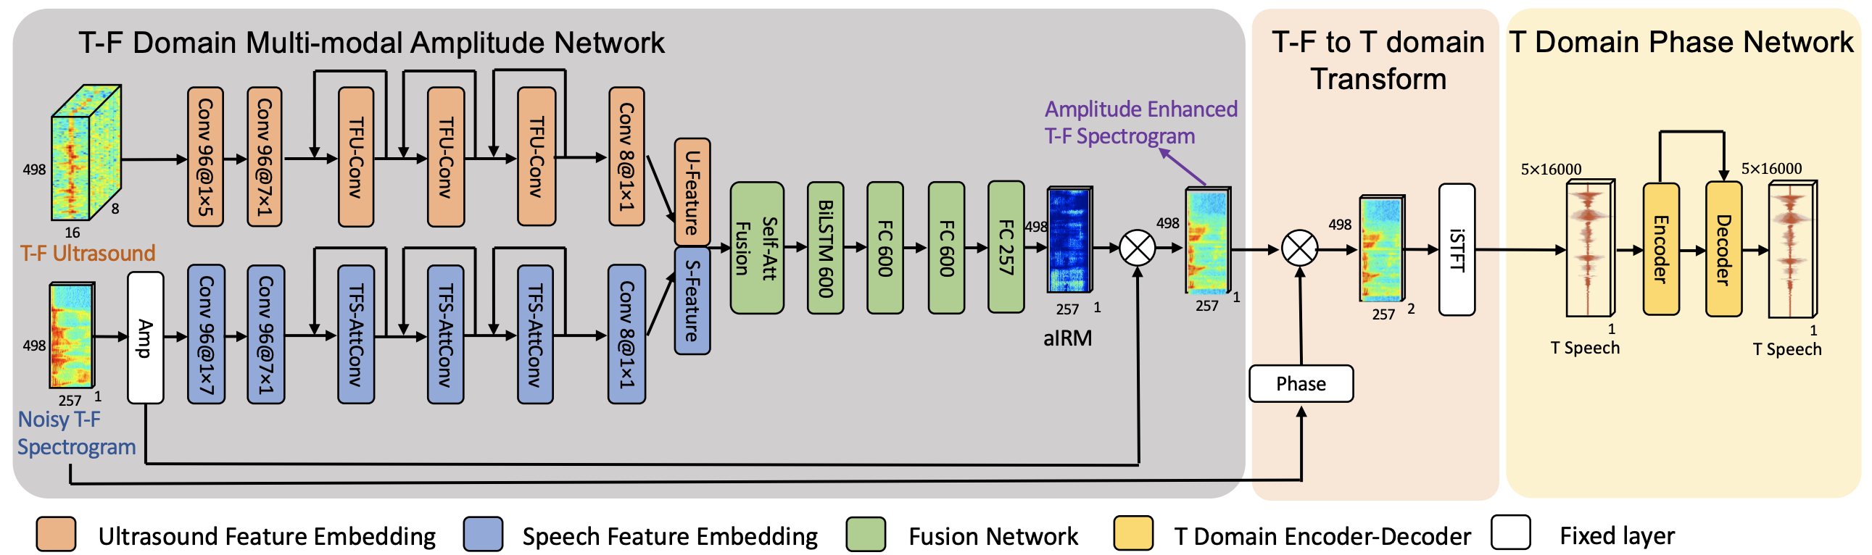
Network Design
T-F domain multi-modal amplitude network
T domain phase network
Notes:
Next, we introduce our neural network design for UltraSE. We integrate the ultrasonic sensing information into the state-of-the-art speech enhancement DNN design. Our design mainly has two parts, time-frequency domain multi-modal amplitude network and time-domain phase network.

Slide 13
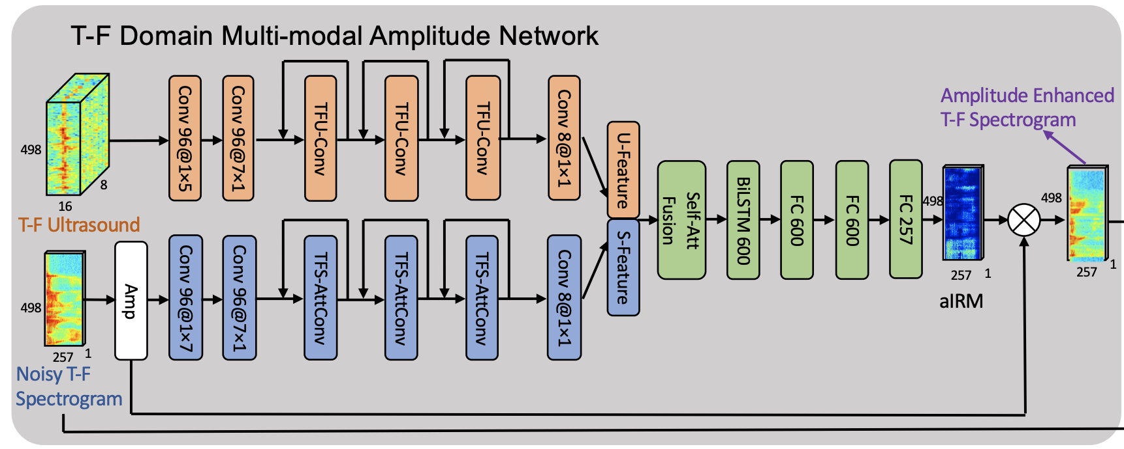
T-F domain multi-modal amplitude network
Amplitude mask
Whether this DNN model fully utilizes the ultrasonic information?
Notes:
The existing speech enhancement DNN methods have shown that using the amplitude of the time-frequency spectrogram can achieve better speech enhancement performance than using the phase.
Thus, we add a time-frequency ultrasound branch in the state-of-the-art amplitude-based speech enhancement deep neural network, use the self-attention mechanism to fuse it with the original sound to generate an amplitude mask of targeted user, and finally generate the amplitude enhanced T-F spectrogram.
However, the key problem here is whether this fusion has fully utilized the ultrasound sensing information? And how can we force the multimodal fusion network to “understand” such multi-modal correlation?

Slide 14
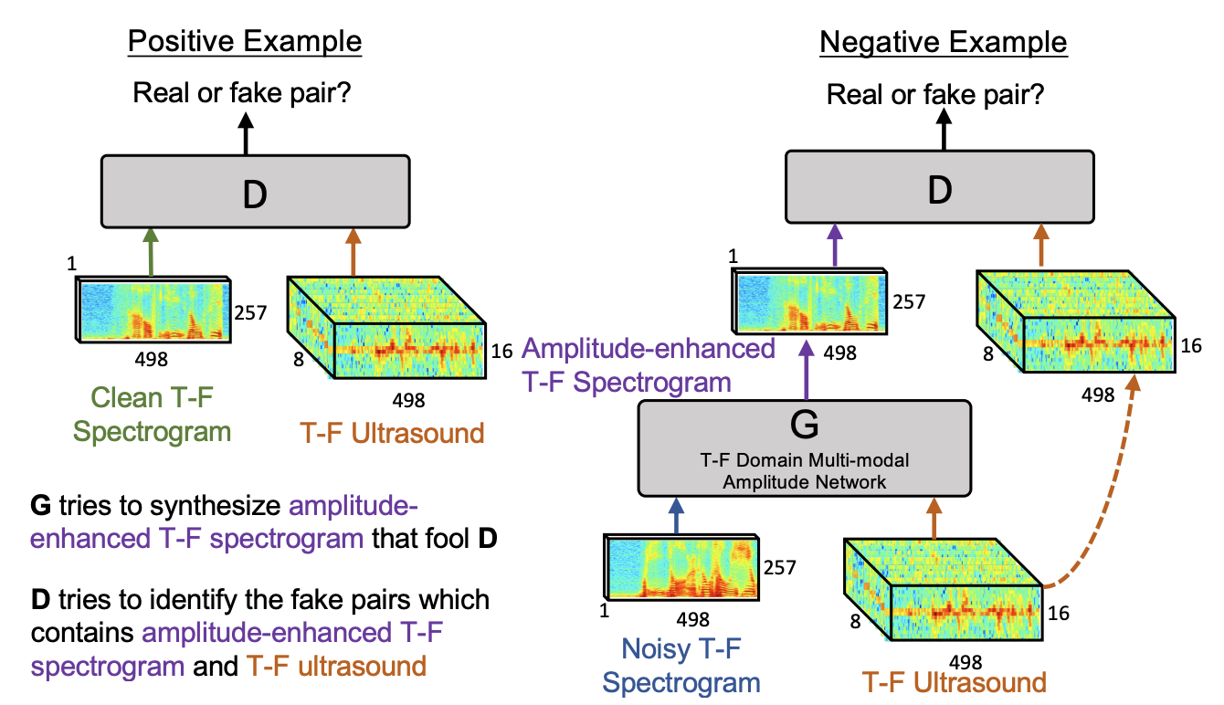
Discriminator Network Design
The audio is too noisy. It is not paired with ultrasound.
We are from the same targeted user.
Notes:
We propose a discriminator network design to see whether the ultrasound corresponds to the speech. As you can see, if the input of discriminator are clean speech and ultrasound feature, it will find that these two are in a pair because they characterizes the same targeted user’s articulatory gestures.
However, when it comes with a noisy speech and ultrasound, it will find that the audible speech is too noisy so that it is not paired with the ultrasound.

Slide 15
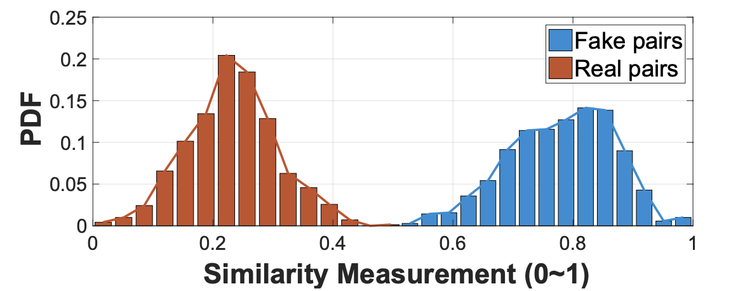
Discriminator Network Design
Triplet Loss C
Learning
Negative: Noisy Speech
Negative: Noisy Speech
Anchor: Ultrasound
Anchor: Ultrasound
Positive: Clean Speech
Positive: Clean Speech
Fake pair: Noisy Speech + Ultrasound
Real pair: Clean Speech + Ultrasound
Notes:
In this discriminator, we propose to use the triplet loss. We are trying to force the ultrasound be close to the clean speech while being away from the noisy speech.
As you can see, after training, the blue and green balls represent to real pair are closer while the blue and red ball representing to fake pair are far away.
Here, we visualizes the distance of real pair and fake pair as red and blue.

Slide 16
cGAN-based cross-modal training
Perfect! They are pair of speech and ultrasound.
The enhanced speech and ultrasound is close to a pair, but not enough, please try a better “G”.
Notes:
And then, we introduce our cGAN-based cross-modal training. Our previously introduced T-F domain multi-modal amplitude network is considered as the generator network to generate an enhanced speech, while the discriminator keeps discriminating whether the enhanced speech is able to pair with the ultrasound. If the discriminator feel the enhanced speech is still not close with the ultrasound, it will update the generator network parameters by back propagation.
Such cGAN based method is general to different multi-modal denoising problems, say, using one modality to recover another modality that is polluted by noise/interference. And also this design is only applied in the training phase to force the neural network to learn the correlation between the ultrasound and speech, which will not introduce any additional computational resource in the testing phase.

Slide 17
Multi-domain Speech Enhancement
How about the phase?
Acceptable speech intelligibility
Poor speech quality
Notes:
Now, we only consider the amplitude of the speech spectrogram in our previous design. The reason why we do not consider the phase information is that most of the T-F spectrogram slot with low amplitude has a random phase.
However, we find that when the speech signals are significantly noisy, the phase of the speech spectrogram will be significantly distorted.
If we do not consider the phase, although the speech intelligibility is still high, which means that you can understand the speech, the speech quality will be low, which means people will feel uncomfortable and realize some jitter effect when they listen to the speech.

Slide 18
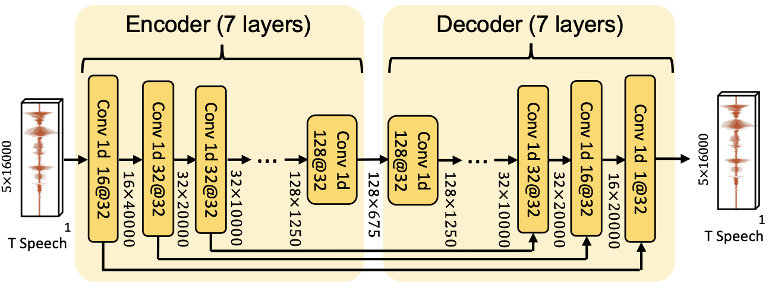
Multi-domain Speech Enhancement
Stage 1: T-F domain multi-modal amplitude speech enhancement.
Stage 2: T domain speech phase enhancement.
Notes:
Thus, after the time-frequency domain amplitude speech enhancement, we propose to fine-tune the phase of the speech. We find that learning the phase information in the time-frequency domain is extremely hard. We propose to convert the time-frequency speech spectrogram to the time domain and use an encoder and decoder design to correct the phase of the clean speech to improve the speech quality.

Slide 19
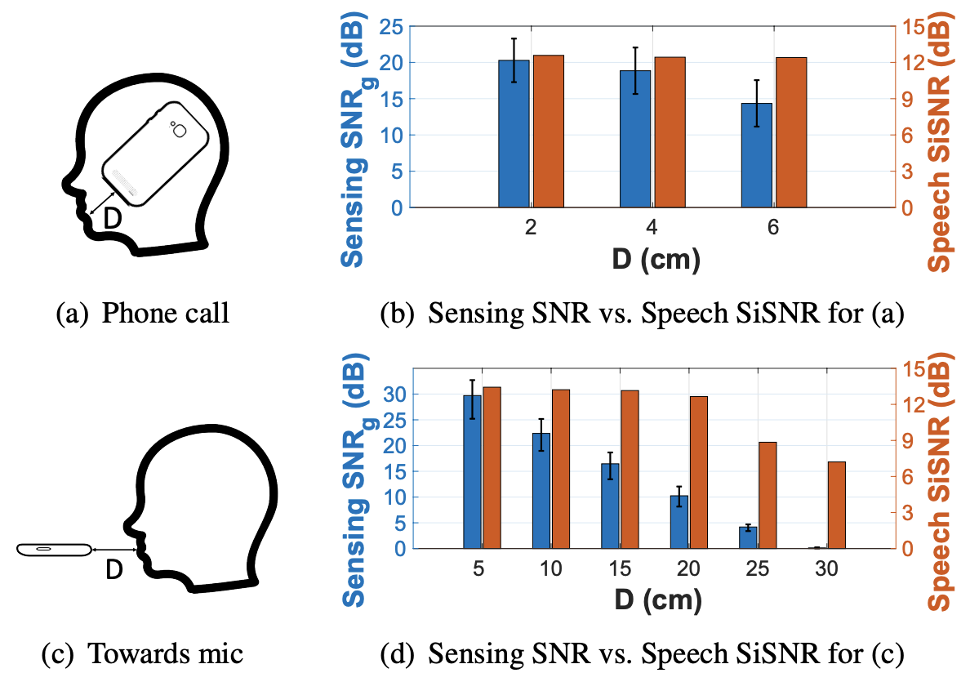
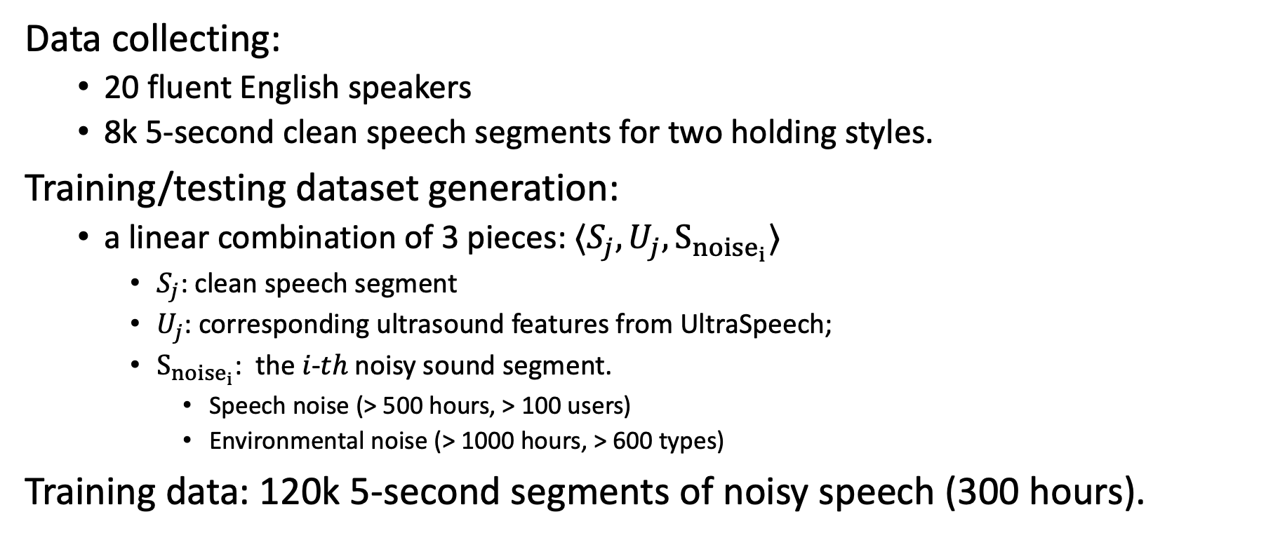
UltraSpeech Dataset
Data collecting:
20 fluent English speakers
8k 5-second clean speech segments for two holding styles.
Training/testing dataset generation:
a linear combination of 3 pieces: ⟨$S_{j}, U_{j}, S_{{noise}_{i}}$⟩
$S_{j}$: clean speech segment
$U_{j}$: corresponding ultrasound features from UltraSpeech;
$S_{{noise}_{i}}$: the 𝑖-𝑡ℎ noisy sound segment.
Speech noise (> 500 hours, > 100 users)
Environmental noise (> 1000 hours, > 600 types)
Training data: 120k 5-second segments of noisy speech (300 hours).
Notes:
Traditional speech datasets only contain raw speech without ultrasound sensing signals. To evaluate UltraSE, we thus create a new dataset called UltraSpeech which compromises both. We recruited 20 fluent English speakers to collect the UltraSpeech dataset. Each participant was asked to say at least 300 sentences in the speech recognition corpus by using 2 typical phone holding styles, “Phone Call” and “Towards Mic” modes.
Note that we only need to collect the clean speech set with ultrasound sensing signals. For the noisy speech part, we can directly use the speech and noise sources from existing dataset to build a large dataset. We use large-scale librispeech dataset and google audioset dataset as the noisy speech dataset and noisy environment dataset. Finally, our dataset achieves more than 300 hours data in total.

Slide 20
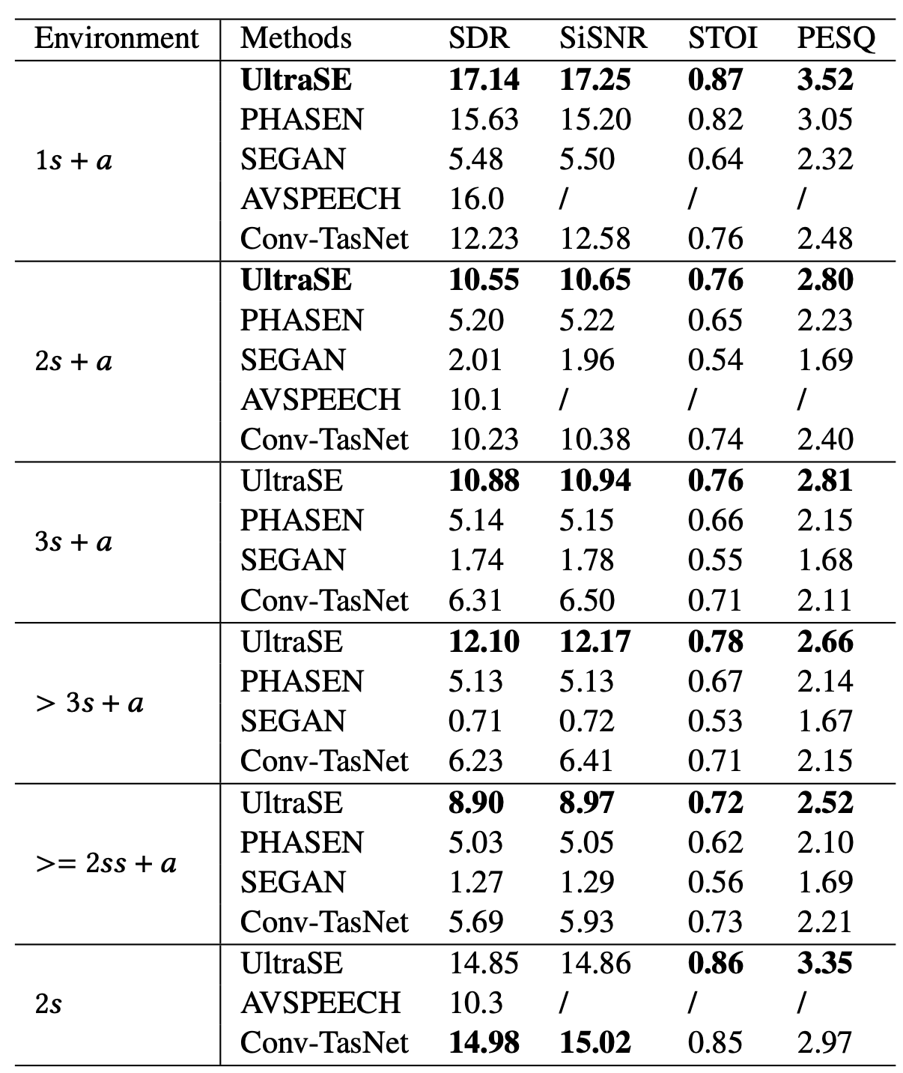
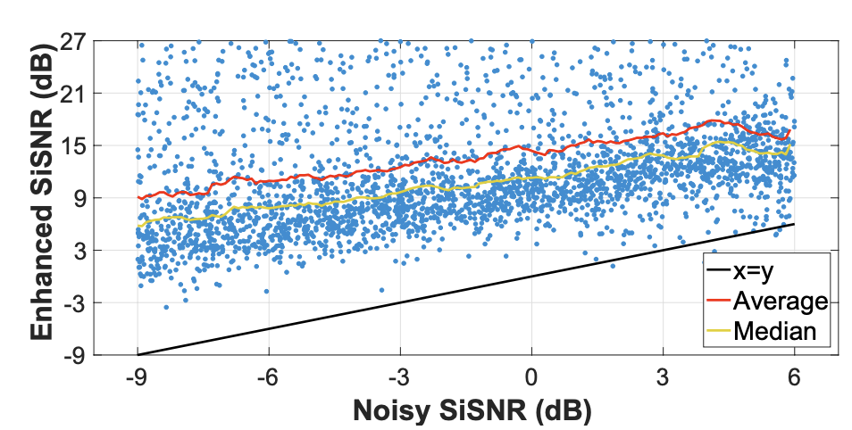
Evaluations
Compared to STOA, UltraSE significantly improves the speech quality and intelligibility in different environments.
Notes:
We compare UltraSE with state-of-the-art speech enhancement methods in different scenarios.
As you can see in this table, in the first column ``environment’’, ``s’’ means the number of the users in the environment while ``a’’ means whether there exists the environmental noise.
We can see that UltraSE outperforms these methods in different scenarios in different speech enhancement metrics.
Even in the scenario with more than 3 speakers and ambient noise, it also works well.
We also test it in a challenging scenario with two same voice, the performance only slightly degrades.

Slide 21
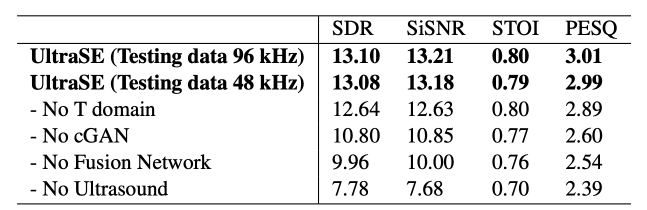
Ablation Study
Ultrasound significantly improve the performance of speech enhancement
cGAN design forces the network to learn the correlation between the ultrasound and speech.
T-domain phase fine tuning brings the speech quality to the next level.

Slide 22
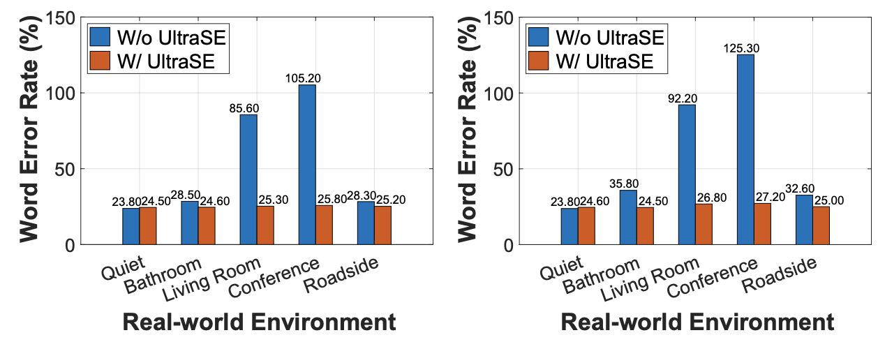
Generalization
Overall, UltraSE will outperforms the case w/o UltraSE in different holding styles.
The UltraSE model is unaffected by the motion artifacts in daily usage scenarios.
1) Bathroom environment: 75 dBA
2) Living room environment: 55 dBA
3) Indoor conference environment: 60 dBA
4) Outdoor roadside environment: 60 dBA

Slide 23
Conclusion
A novel design choice for using ultrasound to assist speech processing.
A multi-modal multi-domain DNN framework for single-channel speech enhancement.
A cGAN-based cross-modal training methods for multi-modal denoising.
UltraSE points to a novel direction that fuses wireless signals to tackle the challenge in traditional speech processing community.

Slide 24
Thank you
Q&A

